Slide 1



SHIELD INSURANCE COMPANY ANALYSIS
SECURE YOUR TOMORROW
A PRESENTATION BY ADITYA SAI V

Slide 2


AGENDA
About Shield insurance
Objective of the Project
Key Metrics and Insights
Dashboard
Detailed Insight overview
Recommendations

Slide 3

ABOUT
Shield Insurance, a dynamic player in the insurance industry, was founded in with a vision to redefine customer-centric insurance solutions. Headquartered in India, Shield Insurance operates across major metropolitan and tier-2 cities, offering a diverse portfolio of health, life, and property insurance products. With a mission to "Protect Today, Empower Tomorrow," Shield Insurance combines cutting-edge technology and personalized services to meet the evolving needs of its policyholders.
Shield Insurance has a strong footprint in key regions like Delhi NCR, Mumbai, Hyderabad, and Chennai, with a network of offline agents and a robust online platform. The company has achieved a 80% year-on-year growth in revenue, driven by its flagship health insurance policy, POL2005HEL, and a growing customer base in the 31–50 age group.

Slide 4


OBJECTIVE
DISPLAY TOTAL CUSTOMERS, REVENUE, DAILY CUSTOMER GROWTH, AND DAILY REVENUE GROWTH TO TRACK BUSINESS PERFORMANCE.
SHOW MONTH-OVER-MONTH PERCENTAGE CHANGES IN KEY METRICS TO IDENTIFY GROWTH PATTERNS. AND INCLUDE A SWITCH BETWEEN REVENUE AND CUSTOMER TREND GRAPHS
PROVIDE A BRREAK DOWN OF TOTAL REVENUE AND CUSTOMERS BY AGE GROUP AND CITY TO PINPOINT PROFITABLE DEMOGRAPHICS AND REGIONS.
PROVIDE A VISUAL TO ANALYZE CUSTOMER SEGMENTATION BY AGE GROUPS, CITIES, AND SALES MODES TO IDENTIFY REVENUE AND
CUSTOMER TRENDS.
CREATE A DEDICATED PAGE TO ANALYZE CUSTOMER AND REVENUE SPLIT BY SALES MODE AND TRACK MONTHLY TRENDS.
DEVELOP A DEDICATED PAGE TO ANALYZE AGE GROUP PREFERENCES FOR POLICIES, SALES MODES, AND EXPECTED SETTLEMENTS.
PROVIDE FILTERS FOR SALES MODE, AGE GROUP, CITY, MONTH, AND POLICY ID FOR TARGETED ANALYSIS.

Slide 5

KEY METRICS AND INSIGHTS
KPI
Value
Insight
Strong Revenue growth in Q1 2023 (+85%).
Policy POL2005HEL has become popular by gained highest revenue through Offline Agents
Delhi is the Most revenue generated city
Total Revenue
$ 989M
+82% growth surged in March 2023 (Q1)
Policy POL4321HEL has gained highest customer through Offline Agents
Delhi has attracted highest no.of customers overall
Total Customers
27K
Daily Customer Growth
April 2023 saw the most customer declines.
Delhi attracted the most daily customers.
148
Daily Revenue Growth
Mar 2023 saw the most DRG i.e $ 8.5M (+60%)
Delhi attracted the most daily customers.
$ 5.5M

Slide 6
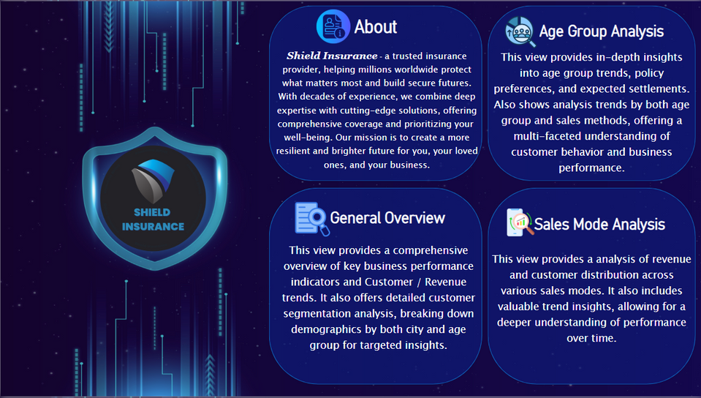
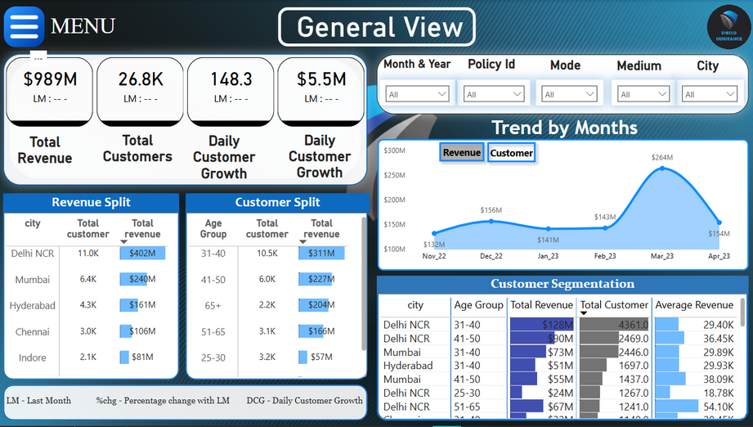
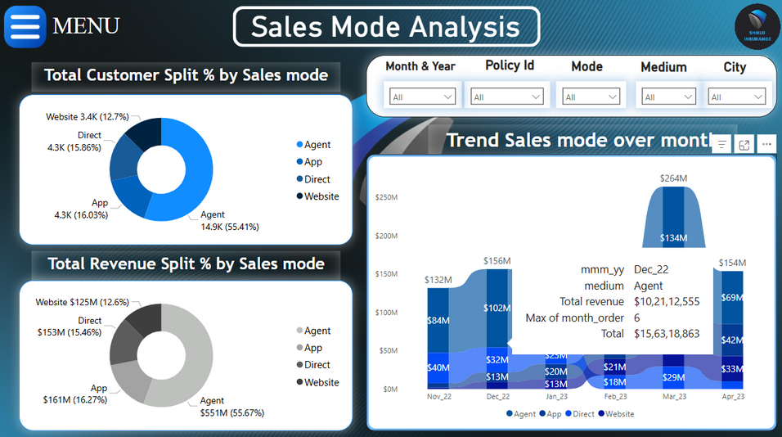
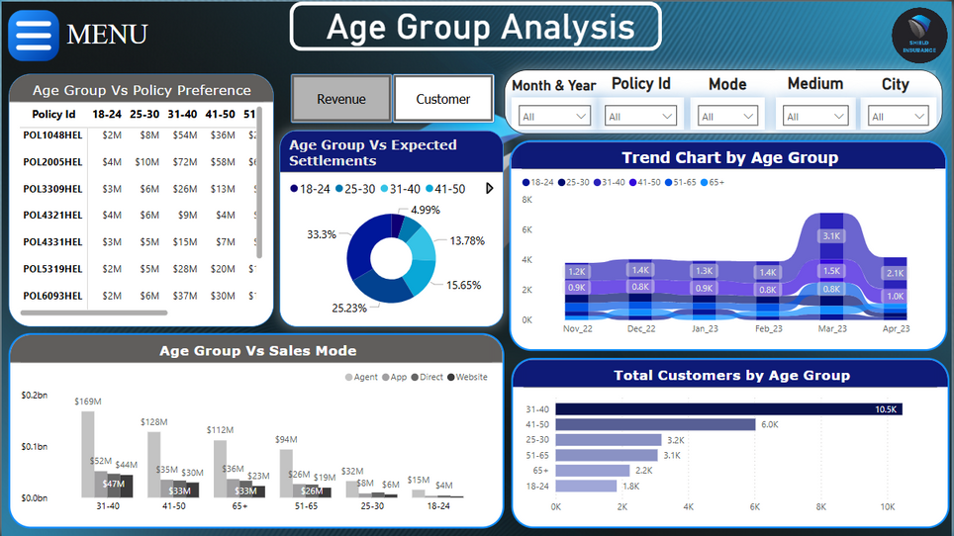
DASHBOARD
CLICK HERE

Slide 7

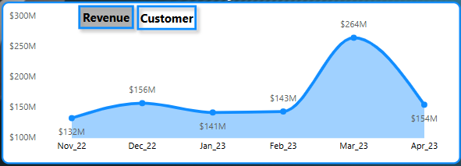
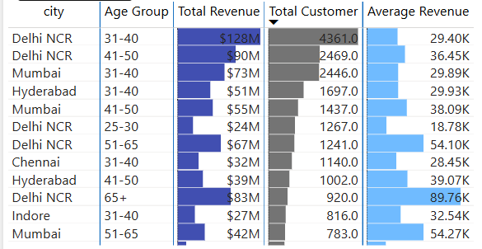
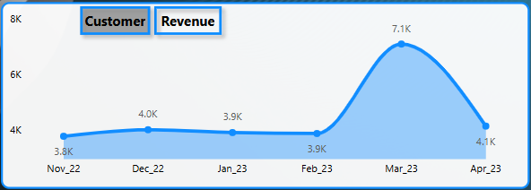
KEY INSIGHTS
The march 2023 shows highetst revene generated while Nov 2022 ‘s remains as lowest revenue generated month overall
Despite having more no.of customers than Dec 22 Apr 23 shows less Revenue
Again Mar 23 has attracted the most no.of customers while Nov & Feb are recorded with lowest cutomers
Delhi NCR Dominates Revenue and Customers: Delhi NCR consistently appears at the top for both total revenue and total customers across various age groups, indicating it's a major market.
Significant Revenue Contribution from 31-50 Age Groups: The 31-40 and 41-50 age groups in Delhi NCR and Mumbai are major revenue drivers.
High Average Revenue in Older Age Groups: While not always the highest in total customers or revenue, older age groups (e.g., Delhi NCR 65+, Delhi NCR 51-65, Hyderabad 41-50, Mumbai 41-50) show remarkably high average revenue per customer. This suggests these segments, though perhaps smaller in volume, are more lucrative on an individual basis.
The drop between March and April suggests potential external market influences or operational shifts impacting revenue stability and customer Trust.

Slide 8
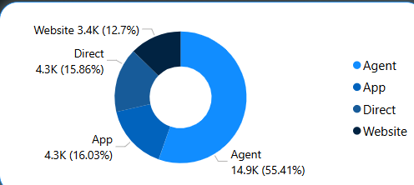
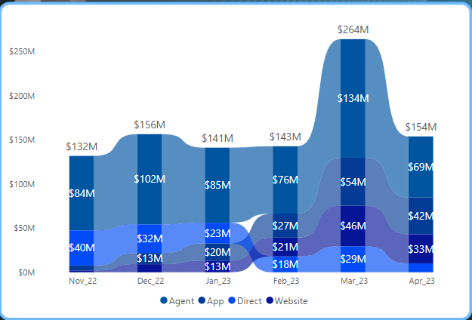
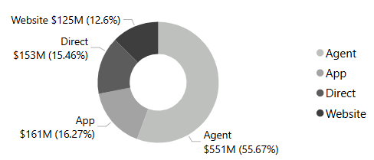
KEY INSIGHTS
The "Agent" channel is the dominant source of customers, accounting for over half (55.41%) with 14.9K customers. "App" and "Direct" channels contribute similarly, each bringing in around 4.3K customers (approximately 16%), while the "Website" channel has the smallest share with 3.4K customers (12.7%). This indicates a strong reliance on agent-based customer acquisition.
Significant Sales Peak in March 2023: Total sales reached an all-time high of $264M in March 2023, representing a substantial increase from previous months.
Agent Channel Dominates Revenue: The "Agent" channel consistently contributes the largest portion of revenue across all months, with its contribution peaking at $134M in March 2023.
"App" Channel Shows Strong Growth and Volatility: The "App" channel experienced significant growth leading up to March 2023 ($54M), but then saw a sharp decline in April ($42M), indicating some volatility.
"Website" and "Direct" Channels Maintain Smaller, Consistent Contributions: Both "Website" and "Direct" channels show relatively stable and smaller contributions to overall
The "Agent" channel is by far the largest revenue generator, contributing over half (55.67%) of the total revenue at $551M. The "App" channel is the second largest with $161M (16.27%), closely followed by "Direct" at $153M (15.46%). The "Website" channel contributes the least revenue at $125M (12.6%), highlighting its relatively minor role in total sales.

Slide 9
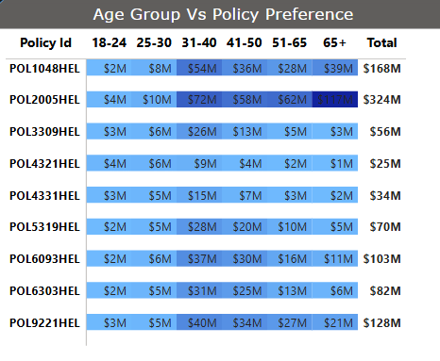
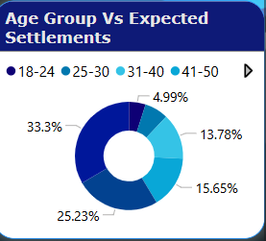
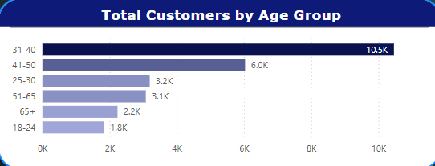
KEY INSIGHTS
Policy POL2005HEL is the highest-grossing policy at $324M, with a significant portion of its revenue ($117M) coming from the 65+ age group, indicating a strong preference among seniors. The 31-40 and 41-50 age groups consistently contribute substantial revenue across most policies, particularly for POL1048HEL and POL2005HEL. Conversely, policies like POL4321HEL and POL3309HEL show overall lower revenue and less significant contributions from older age segments.
The 65+ age group accounts for the largest proportion of expected settlements at 33.3%, indicating a significant financial obligation towards this older demographic. Following closely, the 51-65 age group represents 25.23% of expected settlements. In contrast, the younger age groups (18-24 and 25-30) have the lowest expected settlements, accounting for 4.99% and 13.78% respectively.
The 31-40 age group has the highest number of customers at 10.5K, significantly outnumbering all other groups. The 41-50 age group is the second largest with 6.0K customers, while the 65+ and 18-24 age groups have the fewest customers at 2.2K and 1.8K respectively.

Slide 10
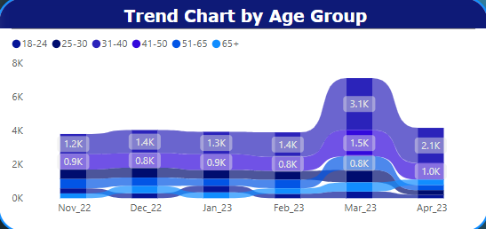
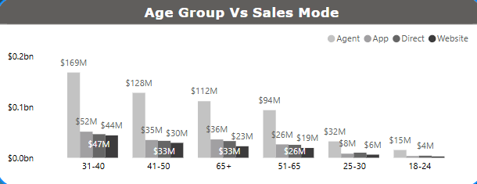
KEY INSIGHTS
The 31-40 age group consistently forms the largest segment across all months, showing a significant surge to 3.1K in March 2023. The 41-50 age group also maintains a substantial presence, particularly noticeable with an increase to 1.5K in March 2023 and 2.1K in April 2023. While younger age groups (18-24, 25-30) remain relatively stable at lower numbers, there's a general upward trend in customer numbers across most age groups towards March and April 2023, with a notable overall peak in March.
The "Agent" sales mode is the dominant channel across all age groups, particularly for the 31-40 age group ($169M) and the 41-50 age group ($128M). The "App" and "Direct" sales modes show comparable contributions for the 31-40 ($52M vs $47M) and 41-50 ($35M vs $30M) age groups, while for the 65+ age group, "App" ($36M) slightly outperforms "Direct" ($33M). The "Website" mode consistently contributes the least revenue across all age segments, indicating it's the least utilized sales channel.

Slide 11

RECOMMENDATIONS
Optimize Agent Channel: Continue robust training and incentives for agents, as they are central to customer acquisition and revenue, especially for high-value policies.
Combat Seasonal Dips: Implement targeted early-year campaigns (e.g., January/February) across all channels to prevent revenue and customer declines.
Target Core Age Groups: Drive growth with loyalty programs for the 25-30 segment and focus marketing on the 31-40 age group for high-revenue policies, as they are key revenue drivers and the largest customer base.
Tailor Product Offerings: Develop digital-first, affordable products for 18-24 to boost volume, and offer comprehensive, agent-led plans for the high-value 65+ demographic to capitalize on settlements.
Enhance Digital Experience: Improve online platform UX with mobile-friendly and gamified features to boost retention, increase online revenue via upsell/cross-sell, and replicate March's online success.
Align Sales & Revenue: Proactively promote high-value policies to ensure customer acquisition directly translates to revenue growth, specifically addressing January's divergence.
Address Low-Value Sales: Analyze reasons behind low-value policy purchases (e.g., January) and implement strategies to upsell higher-value plans.
Utilize Data for Agility: Continuously monitor KPIs and leverage data analytics tools (e.g., drill-down filters, tooltips) for quick insights, enabling proactive anomaly detection and targeted responses.
Strategic Policy Promotion: Aggressively promote POL2005HEL to the 31-40 age group with bundled offers, capitalizing on its high revenue generation and strong preference within this segment.

